Slide 1
Team “Batman” Project – “Store Control”
Team Members:
Надя
Владо
Галин
Ники

Slide 2
Base Class and Class hierarchy
Abstract class Article – base class, every article in store has mandatory properties corresponding for an article (Model, Manufacturer, Price, ID)
Derived by Amplifier, Speakers, MP3Player, HomeTheatre, TV, Monitor, DvdPlayer

Slide 3
Used Interfaces
We need some logical separation between Audio/Video technique, which is accomplished by the following interfaces:
ISoundable – inherited by all audio Articles (Amplifier, Speakers, MP3Player, HomeTheatre)
IVideoPlayable - HomeTheatre, TV, Monitor, DvdPlayer

Slide 4
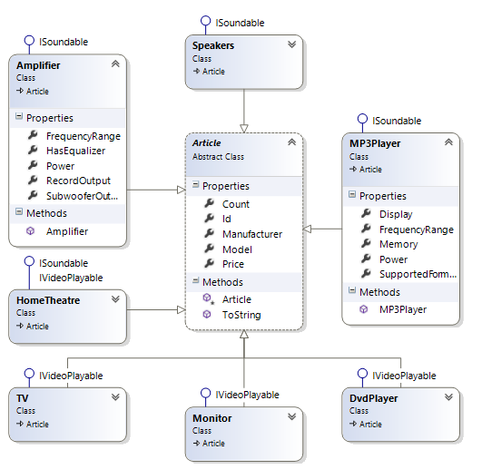
Class Diagram

Slide 5
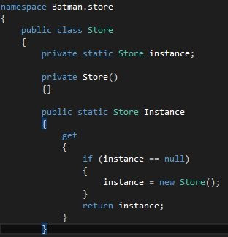
Used Design Patterns
Singleton – used for class Store, as our API has only one instance of Store

Slide 6
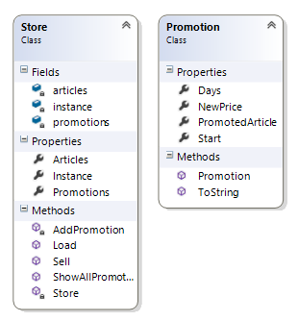
Store & Promotion Diagram

Slide 7

Source Code
Tests & Exceptions

Slide 8
TFS
http://batmanstore.codeplex.com

